Slide 1

English Learner Advisory Committee
ELAC
http://achieve.lausd.net/escwest-parents

Slide 2
OBJECTIVES
Describe the function and composition of ELAC
To acquire knowledge about the DELAC
To acquire the knowledge to run an effective ELAC meeting

Slide 3
State Requirement for ELAC
Education Code 52176(b):
  All schools with twenty-one (21) or more English Learner (EL) students, not including Reclassified Fluent English Proficient (RFEP) students, are required to establish an English Learner Advisory Committee (ELAC).
  All parents with students attending the school in which the ELAC is established are eligible and should be encouraged to participate in the ELAC.

Slide 4
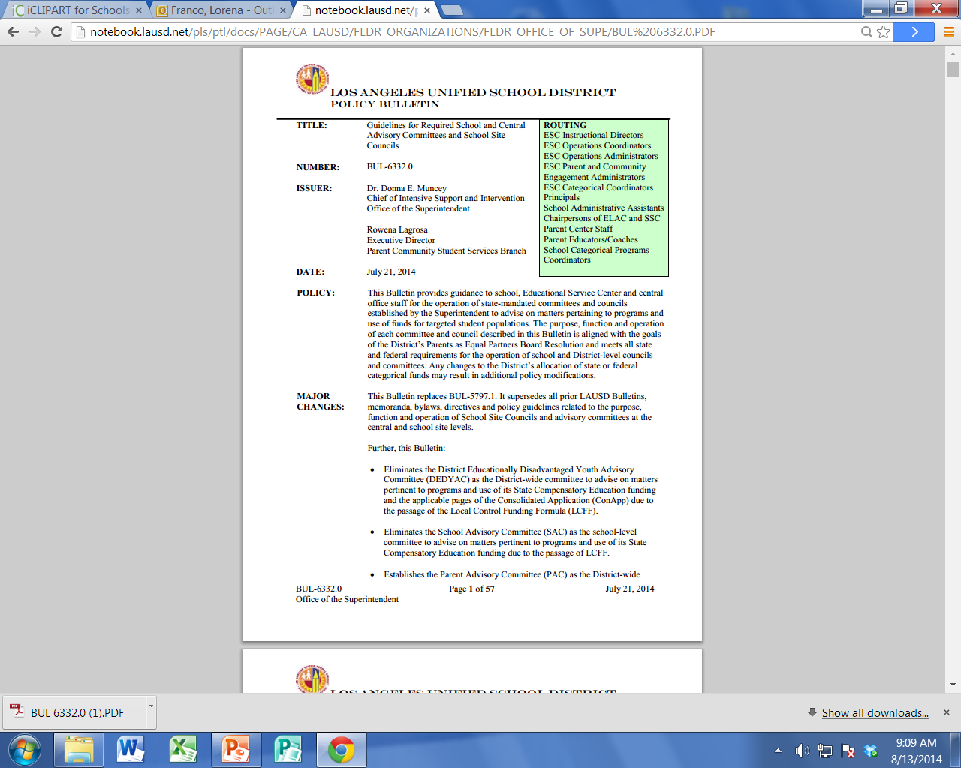


Slide 5

BUL-6332.0
Bulletin 6332.0 Guidelines for Required School and Central Advisory Committees and School Site Councils:
aligns with the requirements set forth by the California Department of Education.
aligns with the purpose and goals of the parents as equal partners resolution.

Slide 6
Composition of ELAC
Is there a minimum number of members?
The ELAC must be composed of no fewer than three (3) members
Number of English Learners in a School | Minimum Number of ELAC Members Required
21 to 75 ELs | A minimum of 3 total members required
76 to 150 ELs | A minimum of 5 total members required
151 to 225 ELs | A minimum of 7 total members required
226 ELs and above | A minimum of 9 total members required

Slide 7
Minimum ELAC Composition Requirement
7
The EL parent membership portion of ELAC must constitute at LEAST 51%.
If the percentage of EL students in a school is greater than 51% of the total number of pupils, then the EL parent membership portion of the committee must be at least the same percentage as the EL student enrollment in the school.

Slide 8

Composition of ELAC
What about the parents of RFEP Students?
Parents may continue to participate in the ELAC as part of the English Learner parent membership portion of the committee for up to two (2) years after their children have been reclassified to Reclassified Fluent English Proficient (RFEP).
Parents of RFEP students are eligible to become ELAC officers.

Slide 9
Processing Activity
ELAC Composition
School | Total EL Student Population | Total Number of ELAC Parents | Required Minimum Number of EL Parents on ELAC
School A | 25% | 25
School B | 80% | 40
School C | 33.5% | 30
School D | 44% | 50
School E | 68% | 10
13
32
16
26
7
Handout #3

Slide 10
Function of ELAC
Provide written recommendations to the SSC regarding programs and services for EL students. Recommendations should be based on student performance and parental involvement data.

Slide 11
Functions of ELAC
California Department of Education & District Mandated Topics
Importance of Regular School Attendance
Language Census
Single Plan for Student Achievement
Comprehensive Needs Assessment
English Learner Master Plan
*A written recommendation(s) MUST be made on each the mandated topics!

Slide 12
ELAC Officers
All ELAC officers must be parents of:
    EL students or
    RFEP students (for up to two years after reclassification)
ELAC officers can not be employed by the District
A member shall hold only one (1) officer position at a time.
Officers cannot serve at two schools during the same school year. Any second designation is null and void.

Slide 13
Responsibilities of ELAC Officers
Perform duties and responsibilities of their elected office
Actively participate in agenda planning meetings
Include information about the District Master Plan for English Learners on their agendas

Slide 14

ELAC Bylaws
ELAC must use bylaws provided by the District.
Bylaws may never conflict with federal, state, or District policies, rules and regulations.
Modifications/amendments must be approved by the ESC/ISIC PACE Administrator.

Slide 15
Operating Norms & Code of Conduct
Abide by all District policies and procedures
Attend and be on time
Be ready to perform the duties of the committee
Refrain from slander
Abide by
The Greene Act
Do not remove District property from any District Facility
Be Respectful
Do not make personal derogatory comments to any person
Do not use profanity
Bylaws
Robert’s Rules of Order
Do no make threats to anyone

Slide 16
ELAC Officers
16
CHAIRPERSON
Preside over all committee meetings
Assist in planning the agenda
Is fair and impartial at all times
Ensure that minutes are properly recorded
Perform additional duties appropriate to the office of the chairperson

Slide 17
ELAC Officers
17
VICE-CHAIRPERSON
Represent the chairperson in his/her absence or in assigned duties
Participate in agenda planning
Assist the chairperson as requested

Slide 18
18
ELAC Officers
SECRETARY
Keep minutes of all regular and special call meetings
Transmit accurate copies of the minutes of all meetings to members
Assist with general communication to members
Assist the principal in maintaining records at the school site for five years
Keep contact information as provided only by the members
Participate in the planning of the agenda

Slide 19
19
ELAC Officers
PARLIAMENTARIAN
Assist the chairperson in ensuring all rules and bylaws are followed
Be knowledgeable about bylaws of the committee, parliamentary procedures, Robert’s rules of Order and the California Open Meeting Law (Greene Act)
Participated in planning of the agenda

Slide 20
Delegation of Authority
Does my school qualify to delegate authority?
The percentage of English Learners in my school does not exceed 50% (elementary schools) or 25% (secondary school).
The SSC has a pre-existing ELAC subcommittee.
The % of EL parents participating in the parent portion of the SSC reflects at least the same % as EL students enrolled in the school.

Slide 21
Delegation of Authority
-Inform all members during a regular (non- election) meeting of the ELAC’s responsibilities
-During a subsequent meeting, establish quorum
-Discuss and vote to delegate the ELAC’s responsibilities to the SSC
-A unanimous vote of the full membership present is required
-Record decision in the ELAC minutes
-ELAC must be
duly constituted
In order to delegate authority of the ELAC to SSC, the ELAC MUST first:
2nd Regular Meeting
1st Regular Meeting
Orientation/
Election

Slide 22
Delegation of Authority
In order to complete the delegation of authority process, SSC members must:
-Submit a Delegation of Authority Form signed by the SSC Chairperson and principal to the SSC PACE Administrator for final approval
-Participate in training to address all ELAC responsibilities
-Accept delegation of authority by unanimous vote

Slide 23
23
DELAC Formation
School Site
ELAC
PCSB
ELAC Delegate
Convening
Central
DELAC

Slide 24
ELAC Delegate Convening
The ELAC Chairperson will automatically serve as the school’s representative to the ELAC delegate convening in their ESC/ISIC.
This designation can NOT be transferred to any other ELAC officer/member.
10 representatives and 2 alternates, from each ESC/ISIC are elected to serve on DELAC.

Slide 25
Central Committee
District English Learner Advisory Committee (DELAC)
  The DELAC advises on matters pertinent to EL Programs.
  Composition and selection
      50 members total
      All members are parents of English Learners
      Members elected at ELAC Delegate Convening
  Meets 4 times per school year excluding trainings.
  Members and officers serve for the duration of the school year.

Slide 26
Open Meeting Law
Any meeting held by the committee shall be open to the public.
Any member of the public shall be able to address the committee during the meeting on any item within the subject matter jurisdiction of the council or committee.
Notice of the meeting shall be posted at the school site or other appropriate place accessible to the public at least 72 hours prior to the meeting.
The meeting notice shall specify the date, time, and location of the meeting and contain an agenda describing each item of business to be discussed or acted upon.

Slide 27
Open Meeting Law (cont.)
The committee may not take any action on any item of business unless
  the item appeared on the posted agenda, or
  the committee members find, by unanimous vote, that there is a need to take immediate action and that the need for action came to the attention of the committee subsequent to the posting of the agenda.
Questions or brief statements made at the meeting by members of the committee, or public need not be described on an agenda as items of business if those questions or statements
  do not have a significant effect on pupils or employees in the school or school district; or
  can be resolved solely by the provision of information.

Slide 28
Open Meeting Law (cont.)
If the committee violates the procedural meeting requirements described above, and upon the demand of any person, the committee shall reconsider the items at its next meeting after allowing for public input on the item.
Any materials provided to a school site council shall be made available to any member of the public who requests the materials pursuant to the California Public Records Act.
Note: Emergency meetings must be posted 24 hours in advance!

Slide 29

3-Step Election Procedures
STEP 1 Informing
Notify all parents and stakeholders of orientation/elections.
Include date, time, location and the agenda items to be addressed.
    STEP 2 Posting
    Orientation notices (agendas) must be posted at least seventy-two (72) hours prior to the scheduled orientation.
    Election notices (agendas) must be posted at least five (5) days prior to the scheduled election.
    Postings must be outside of the school building and must be continuously accessible for all stakeholders.

Slide 30
3-Step Election Procedures
    STEP 3 Meeting
Distribute agenda outlining the objective of the meeting (orientation/election).
Explain the roles and responsibilities of committee and duties of officers.
Declare all seats vacant.
Explain the election procedures for voting.
Note: Refer to district policy for complete guidelines

Slide 31
Documenting an Effective Meeting
ELAC BINDER
agendas
sign-ins
ballots
minutes
bylaws
recommendation forms
handouts
announcements
attendance
record
operating norms
certification form

Slide 32

When in doubt…
PACE Staff

Slide 33
Agenda
The following details must be included in all agendas:
School name and committee name
Meeting date, time and location
Every item of business to be considered in the order to be presented
Opportunity for public input
Next meeting date, time and location
Remember, if it is not written, it does not exist!

Slide 34
Minutes
Minutes must include:
School name and committee name
Meeting date, time and location (specify beginning and ending time)
Attendance record
Record of quorum being (or not) established
Should follow agenda
Detailed record of what was discussed and voted on (motions)
Must be reviewed for accuracy and approved at following meeting

Slide 35
Minutes
Minutes must include:
School name and committee name
Meeting date, time and location (specify beginning and ending time)
Attendance record
Record of quorum being (or not) established
Should follow agenda
Detailed record of what was discussed and voted on (motions)
Must be reviewed for accuracy and approved at following meeting

Slide 36
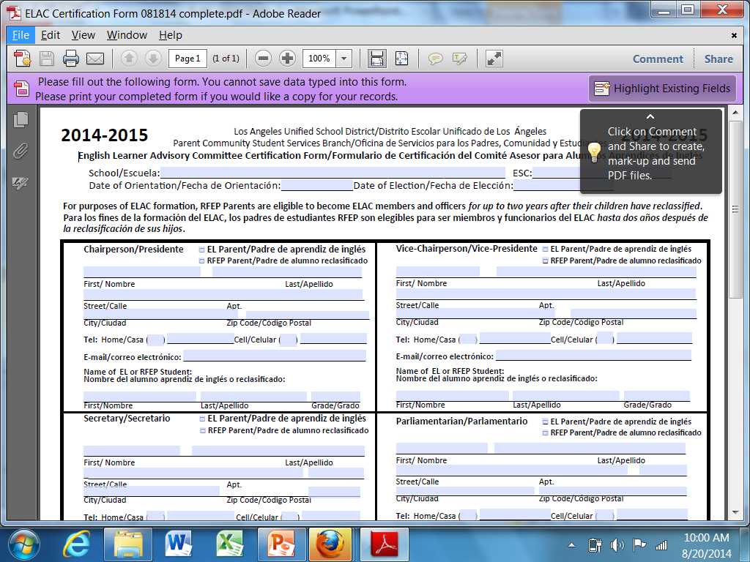
ELAC Certification Form

Slide 37


Slide 38
Thank you!

